Slide 1
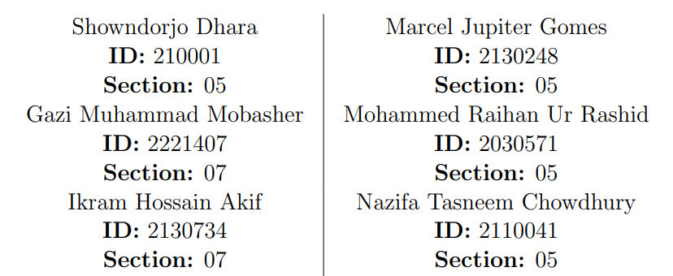
MENTAL HEALTH RESOURCES TEAM 29

Slide 2
1. Introduction
In this project, we have meticulously designed and developed a website dedicated to facilitating access to mental health resources, leveraging the robust capabilities of database management systems. Our approach involved a comprehensive analysis of existing systems within the domain, a thorough examination of relevant journal papers, and the synthesis of this knowledge to create an innovative system with several improvements.
The upcoming presentation encompasses rich visuals, including detailed depictions of existing systems, our newly developed platform, and the corresponding relational schema, normalized schema, and Entity-Relationship Diagram (ERD). These visual aids serve to elucidate the intricacies of our system architecture, illustrating how each component seamlessly integrates to enhance user experience and resource accessibility.
Furthermore, we have implemented a series of structured database tables, meticulously designed to store and manage the diverse array of mental health resources within our system. A detailed video demonstration of our website will complement these visuals, offering a dynamic and immersive overview of the user interface, functionality, and features.
The ensuing sections will provide a comprehensive understanding of the thought process, methodologies, and outcomes of our endeavour, showcasing the tangible impact of our efforts in the realm of mental health resource accessibility.

Slide 3
2. Rich Picture - As Is

Slide 4
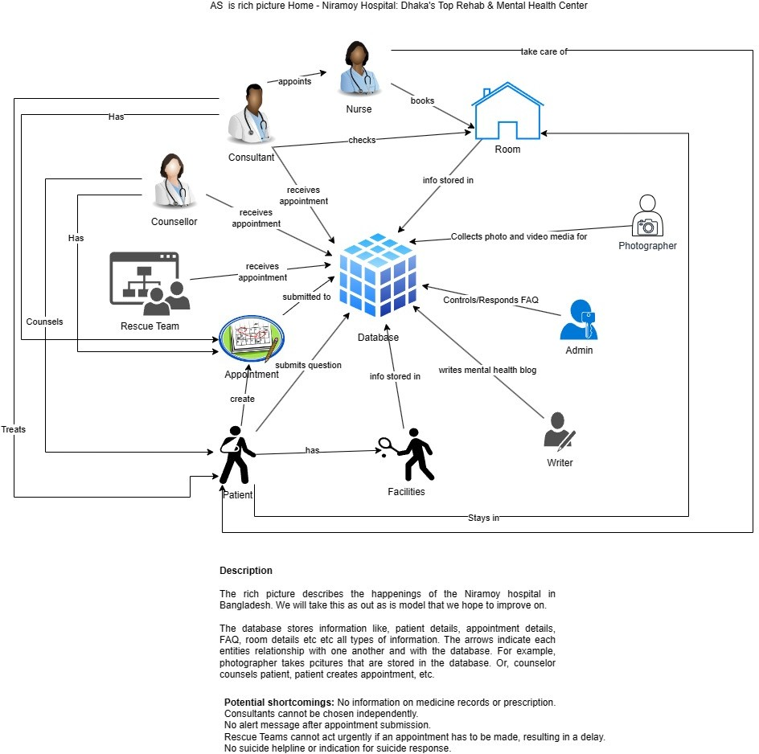

Slide 5
3. Rich Picture - To Be

Slide 6
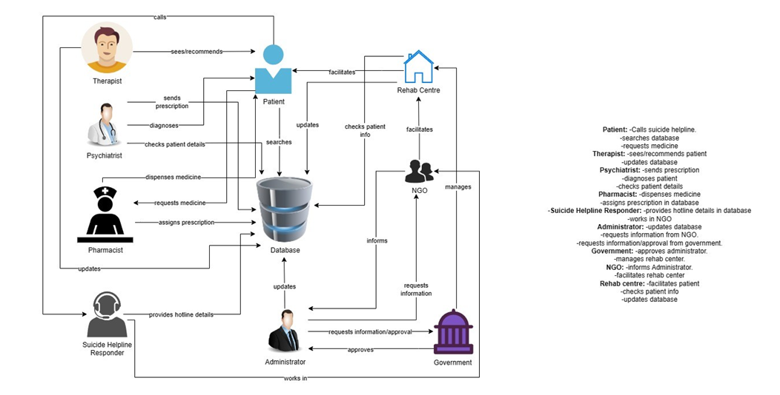

Slide 7
4. Entity Relationship Diagram

Slide 8
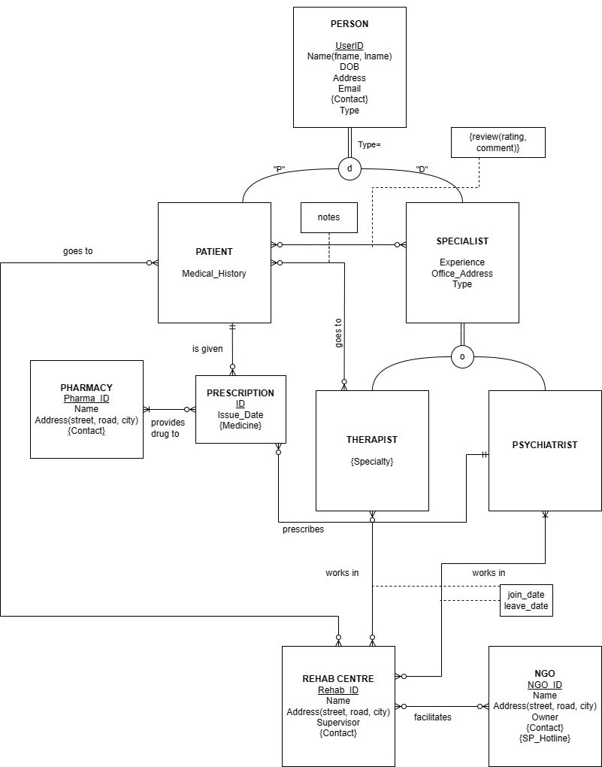

Slide 9
5. Relational Schema

Slide 10
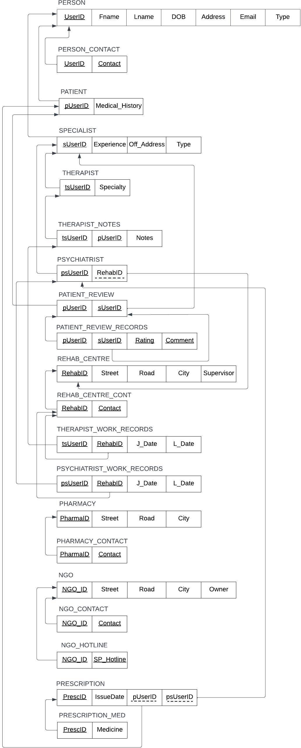

Slide 11
6. Normalized Schema
1NF All tables are already in first normal form; there are distinct primary keys with no multivalued attributes.
2NF All tables are already in second normal form; all attributes are fully dependent on the primary keys of their tables, i.e., no partial dependencies.
3NF All tables are already in third normal form; there are no transitive dependencies that have not been isolated.
BCNF All tables are already in Boyce-Codd Normal Form as there are no determinants that are not candidate keys.
Refer to Slide 10 for the normalized version of the Schema.

Slide 12
7. Implemented
Databases

Slide 13
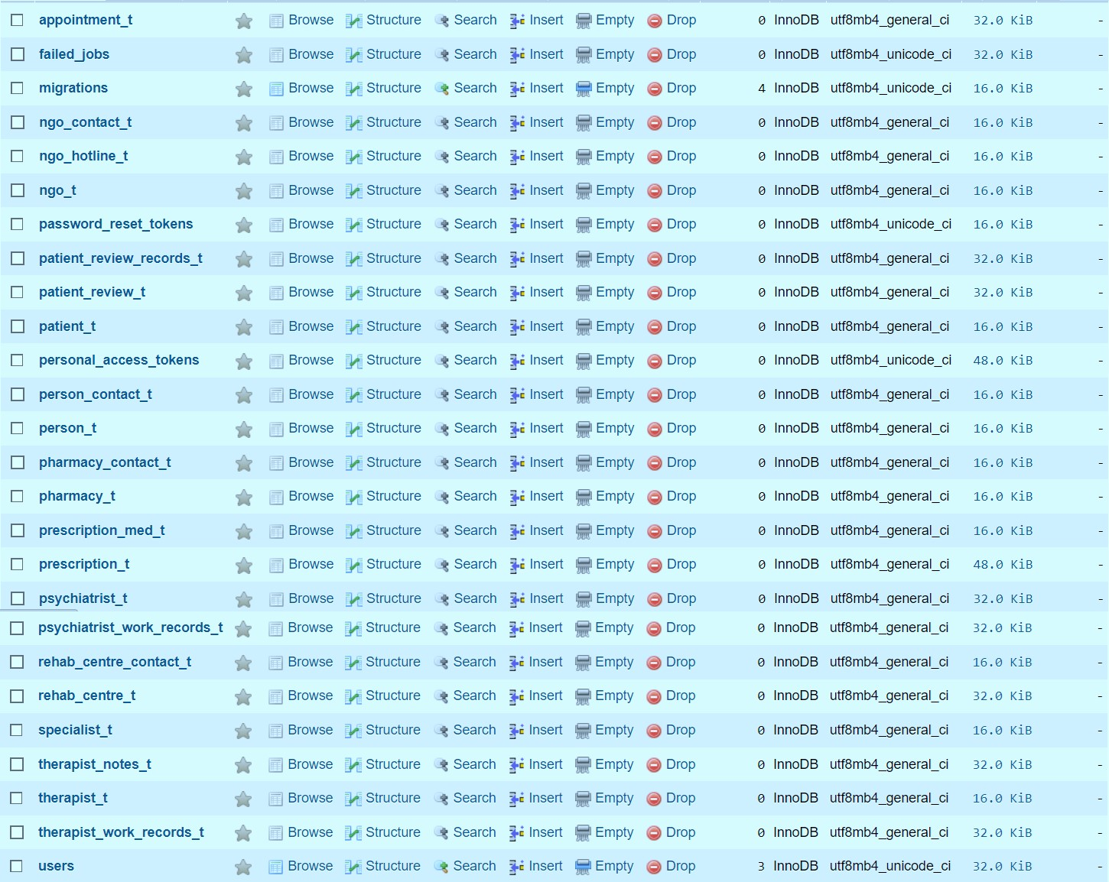

Slide 14
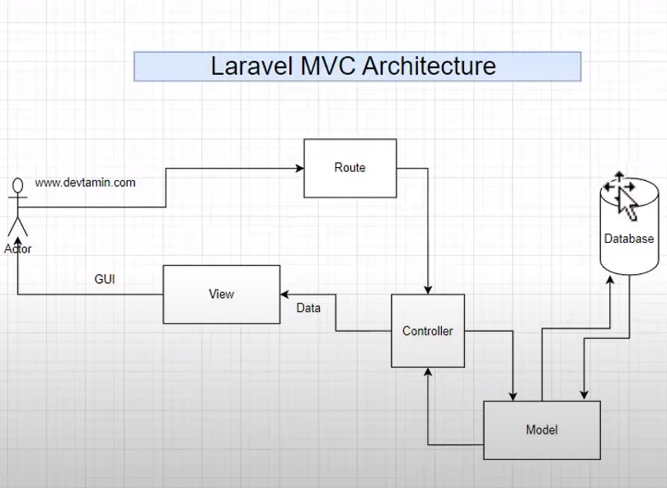

Slide 15

THANK YOU

